Slide 1
Cpt 2 Decision making on the day
    Decision making under stress, in complex situations with time constraints.
    The time taken to make a decision and act on it can increase both the likelihood and consequence of the risk. Not making a decision and inaction may make the situation far worse.
    Characteristics of incidents in crowds:
      complex
      time is important
      information is limited
      potential for chaos

Slide 2
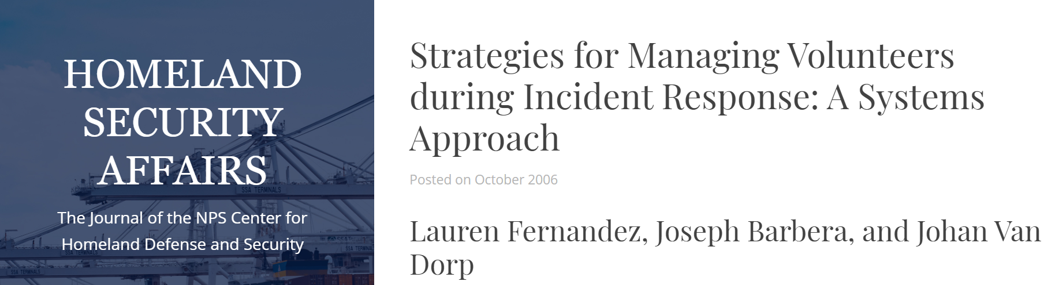
Tools and techniques
Heuristics and the checklist
Situational Awareness
Spontaneous volunteers
Appropriate Response
Proportionality

Slide 3
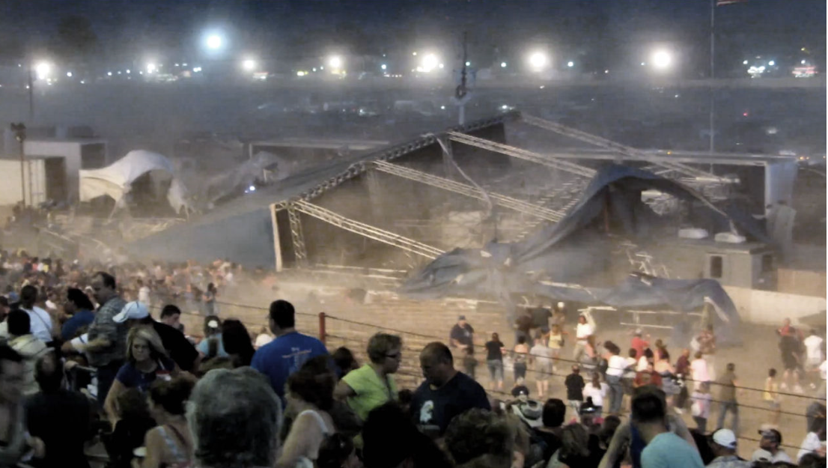
Indiana State Fair stage collapse
There is a Youtube of this disaster.
Examine this and look for the actions of the
spontaneous volunteers.

Slide 4
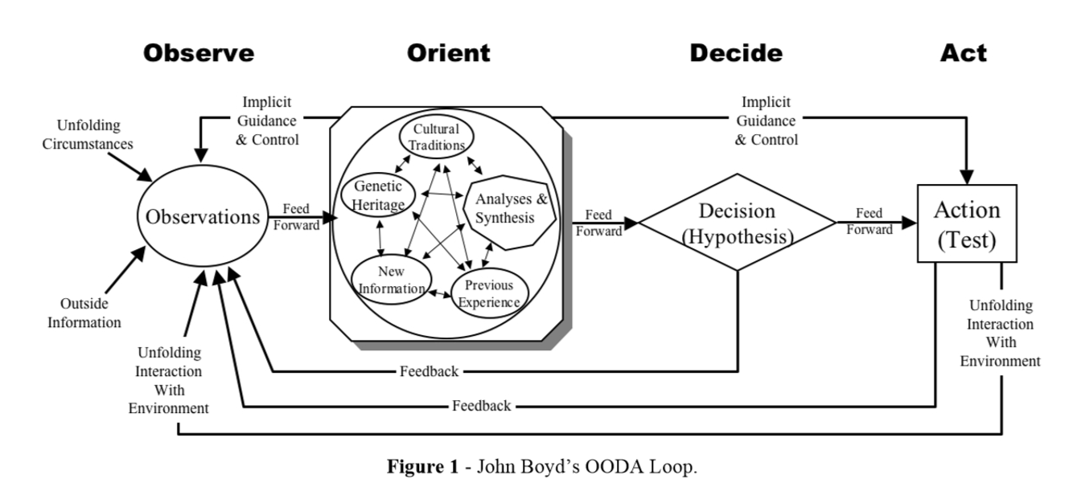
Limited information
Local optimisation
Making the best decision with limited information
Time is not on your side
OODA Loop

Slide 5
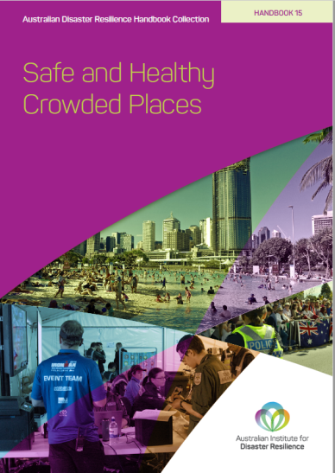
Trigger Points
“used to identify when escalation of management plans is required at a crowded place. Triggers may occur in response to common pre-defined occurrences – e.g. the end of an event or a band’s set list – or in response to emerging hazards and threats, e.g. flow stoppages. Triggers may have different thresholds depending on the type of event and crowd present.
Trigger points for escalation of responses related to crowd
considerations may include a change of these factors:
density
change of mood, including significant increase in humidity
flow stoppage
alcohol and intoxication,
end of the event, or half-time
setlists, e.g. when stages close.
As well as density and flow rates, crowd mood is an indicator of possible problems. All these issues should be considered when there is great stress on the crowd.”
Safe and Healthy Crowded Places AIDR.

Slide 6
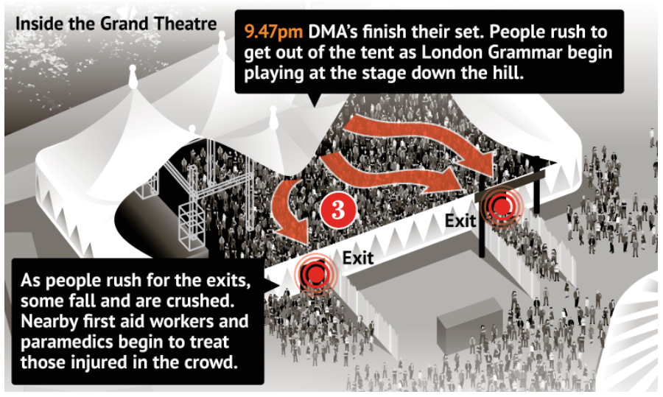
Falls Music Festival : end of set
Looking at the trigger points in the previous slide,
which ones apply to this disaster?

Slide 7
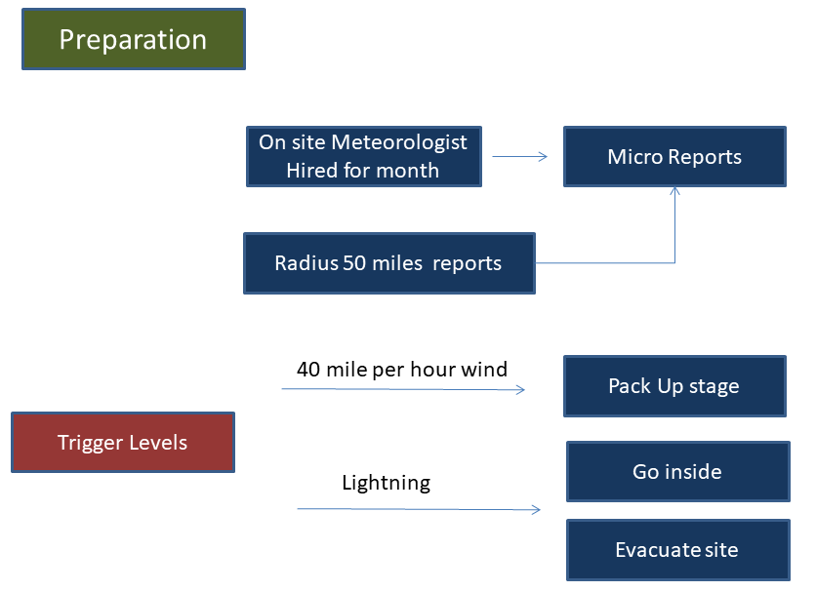
Trigger for Storms

Slide 8
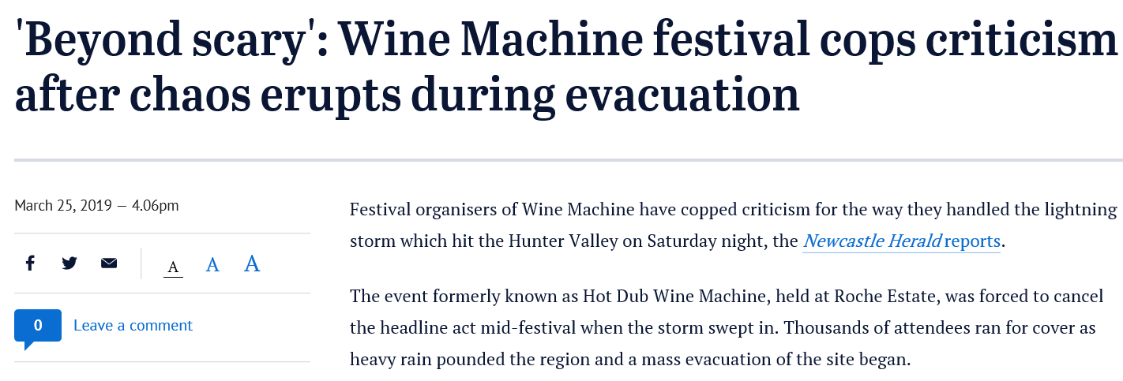
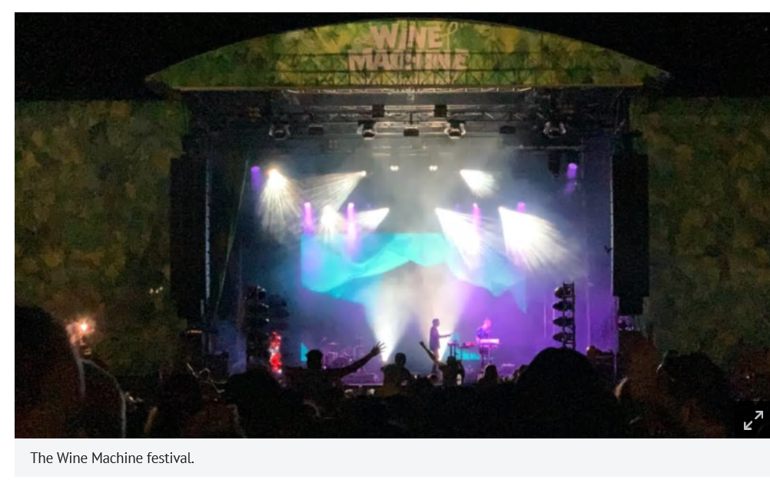
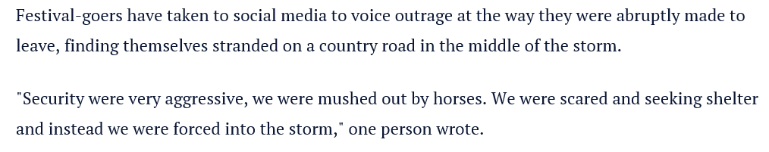
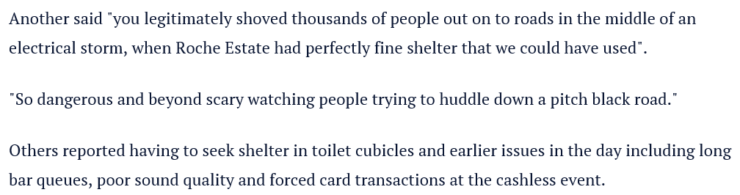
Looking at the decision chart in the previous slide,
can this be applied to this situation?

